Slide 1
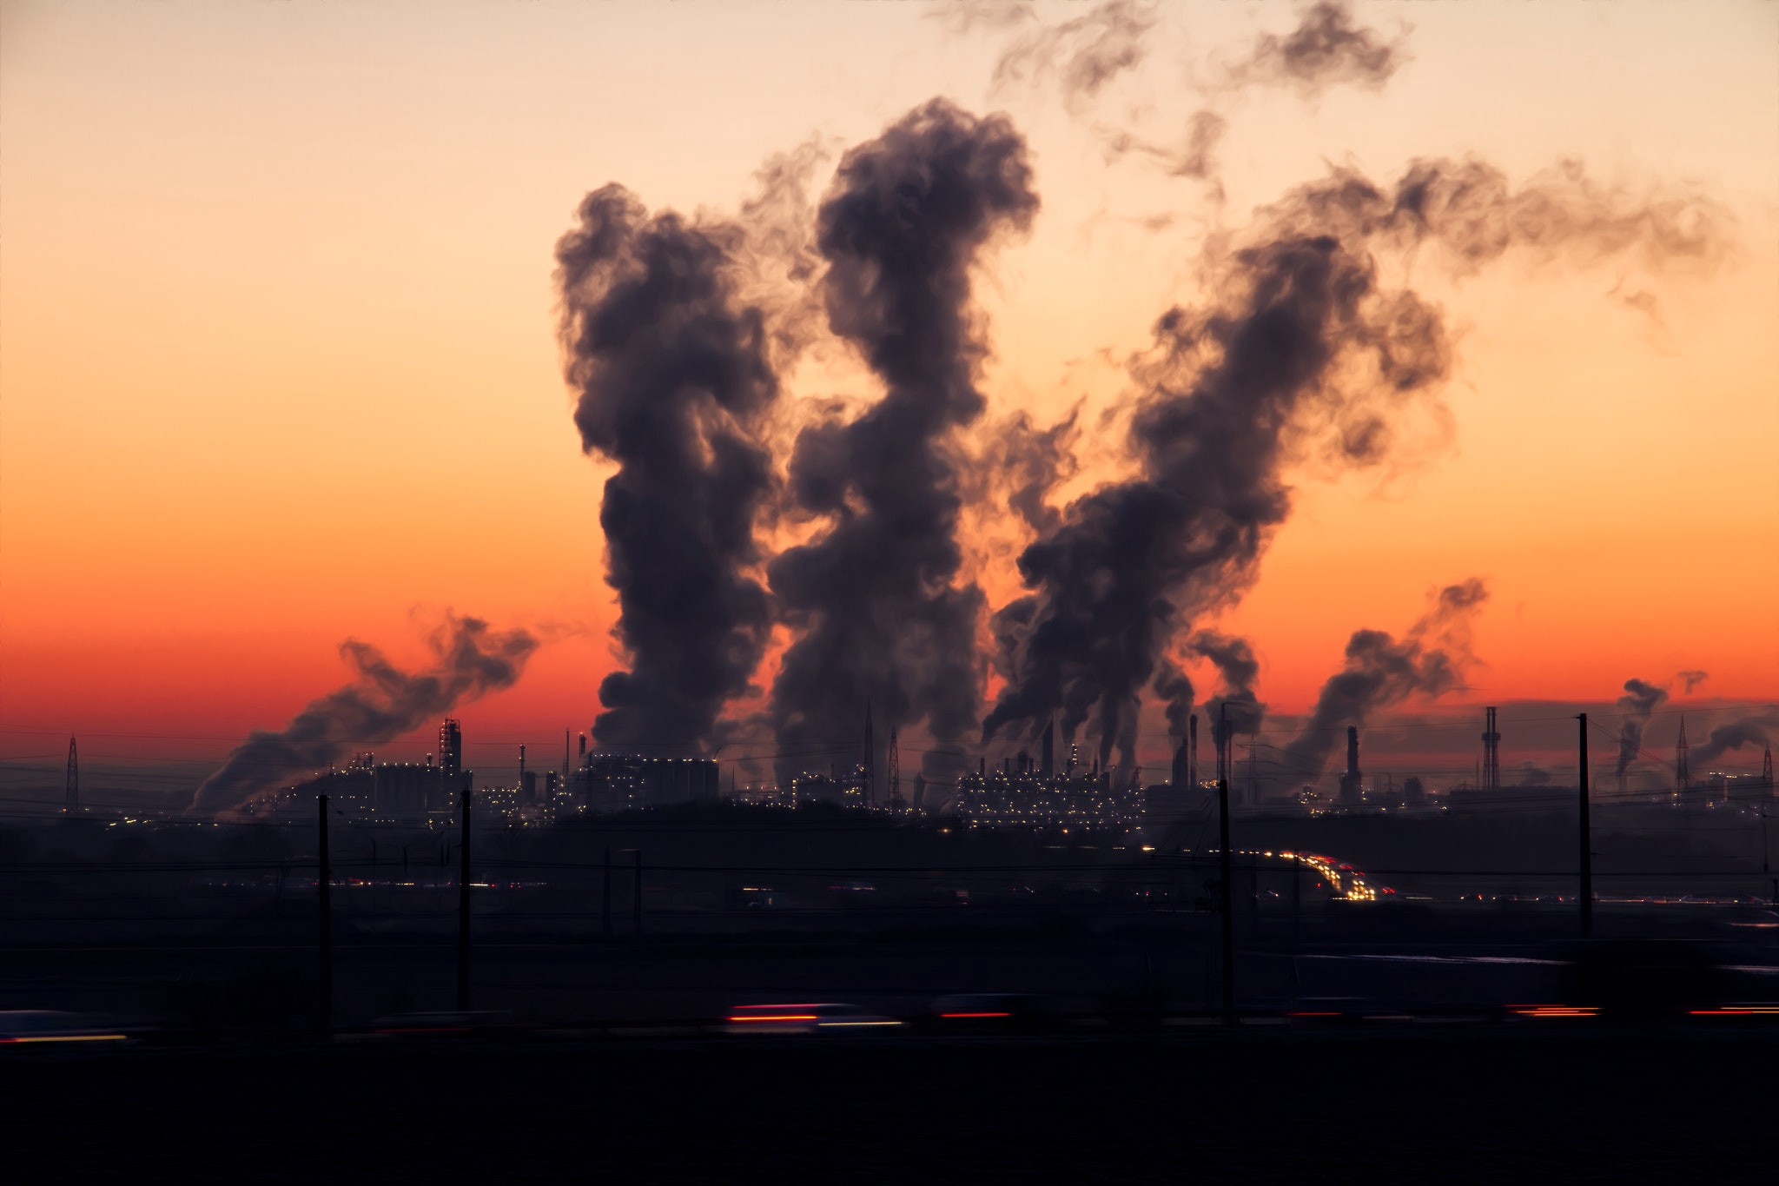
Air Quality Index
By
Challoju Shivani

Slide 2
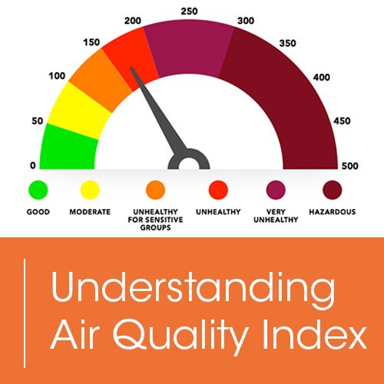
Topics Covered
Introduction
About the dataset
Tools used
Data Cleaning
Data Modelling
Creating Dimension & Fact tables
Loading data into HDFS
Creating tables in Hive
Loading data into tables in Hive
Scenarios

Slide 3
Introduction:
Air pollution in India is a serious issue with the major sources being fuelwood and biomass burning, fuel adulteration, vehicle emission and traffic congestion.
Air Quality Index is the index for reporting daily air quality. Higher the Air Quality Index, higher is the level of air pollution and higher the health concern.
Gases like SO₂ and NO₂ help us to measure the quality of air at a location.

Slide 4
About the dataset :
stn_code : Station code. A code is given to each station that recorded the data.
sampling_date: The date when the data was recorded.
state: It represents the states whose air quality data is measured.
location: It represents the city whose air quality data is measured.
agency: Name of the agency that measured the data.
type: The type of area where the measurement was made.

Slide 5
so2: The amount of Sulphur Dioxide measured.
no2: The amount of Nitrogen Dioxide measured
rspm: Respirable Suspended Particulate Matter measured.
spm: Suspended Particulate Matter measured.
location_monitoring_station: It indicates the location of the monitoring area.
pm2_5: It represents the value of particulate matter measured.
date: It represents the date of recording (It is a cleaner version of ‘sampling_date’ feature)

Slide 6



Tools used:
Talend : It is used to clean data and loading of data.
HDFS: It is used as the main storage file system
Hive: It is used to run all the queries that are used to analyse the data.

Slide 7
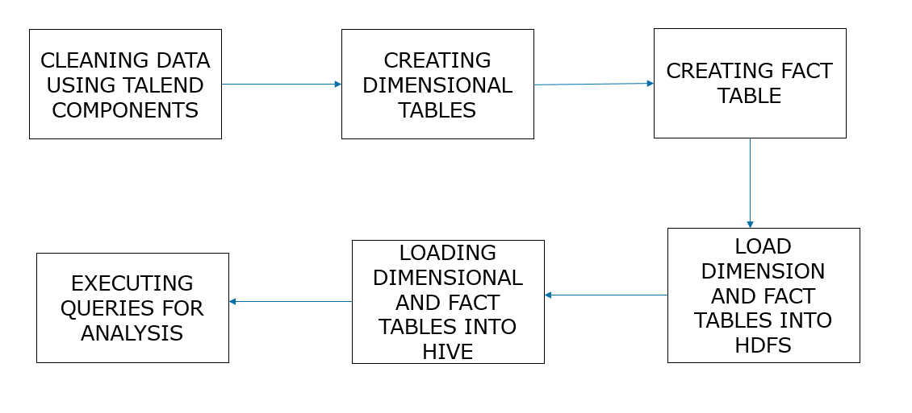
Workflow:

Slide 8

Data Cleaning
Data cleaning is the process of detecting and correcting (or removing) corrupt or inaccurate records from a record set, table, or database and refers to identifying incomplete, incorrect, inaccurate or irrelevant parts of the data and then replacing, modifying, or deleting the dirty or coarse data.
Removing Sampling_date column and rows with null values in date column:

Slide 9
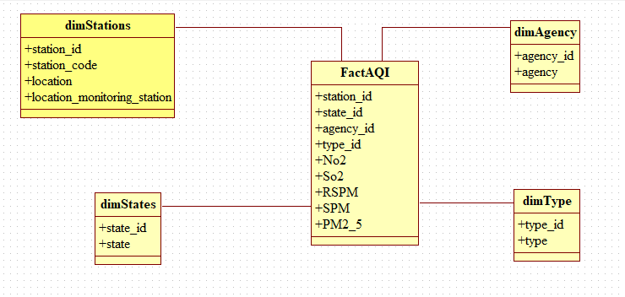
Data Modeling

Slide 10
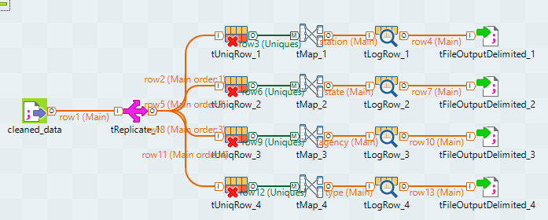
Creating Dimension tables:

Slide 11
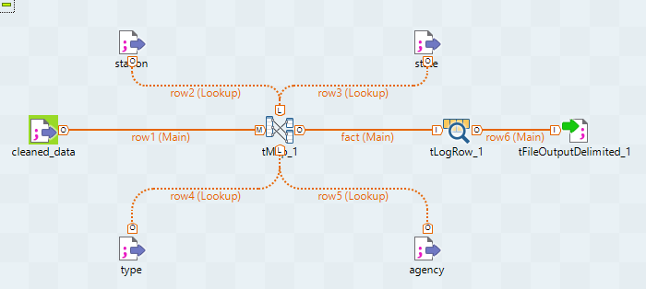
Creating Fact table:

Slide 12
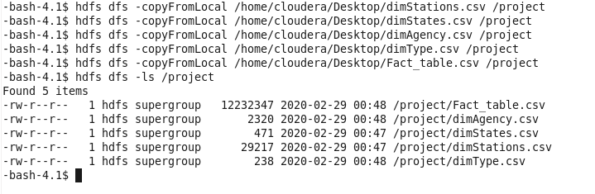
Loading data into HDFS:

Slide 13
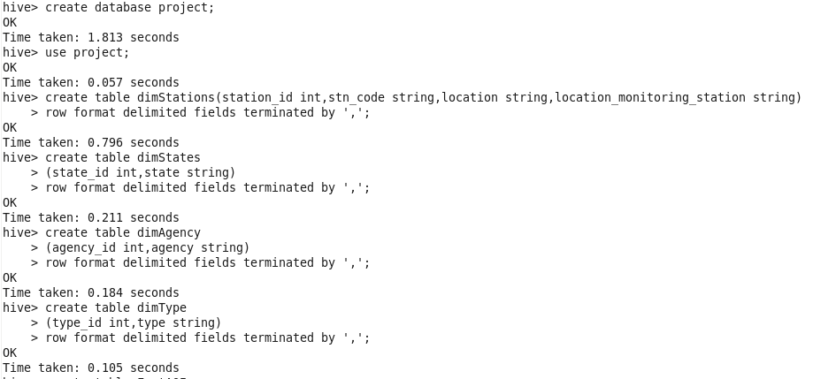
Creating tables in Hive:

Slide 14
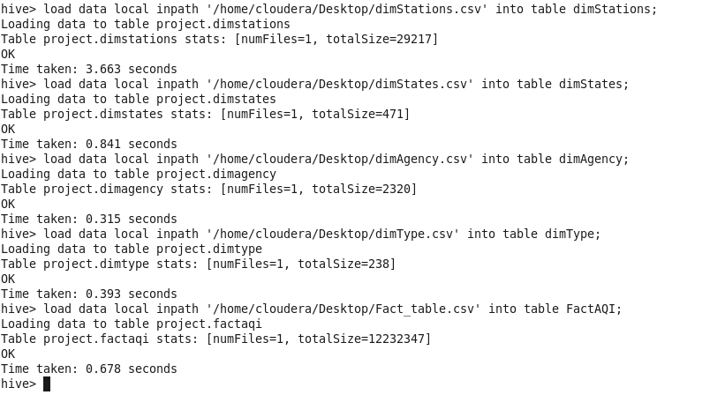
Loading data into tables in Hive:

Slide 15
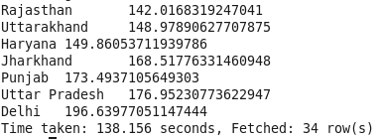
Scenario:1 Fetching the data of RSPM concentration for each state. Query: output:

Slide 16
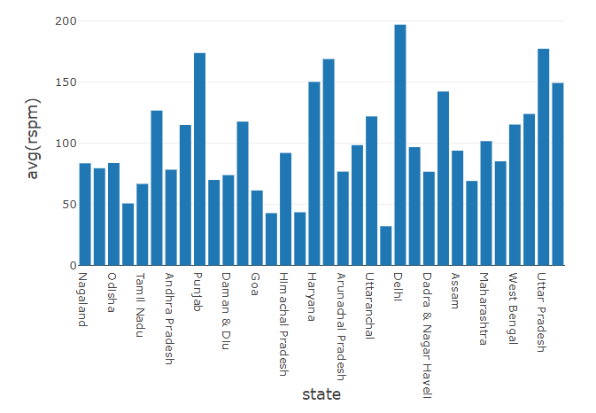
Graphical representation of average RSPM for each state:

Slide 17

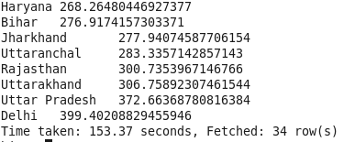
Scenario:2 Fetching the data of SPM concentration for each state. Query: output:

Slide 18
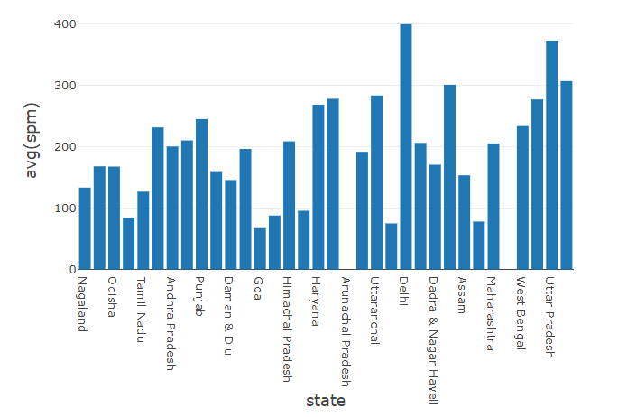
Graphical representation of average SPM for each state:

Slide 19

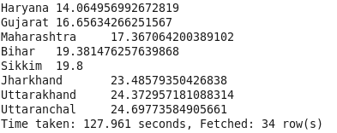
Scenario:3 Fetching the data of SO₂ concentration for each state. Query: output:

Slide 20
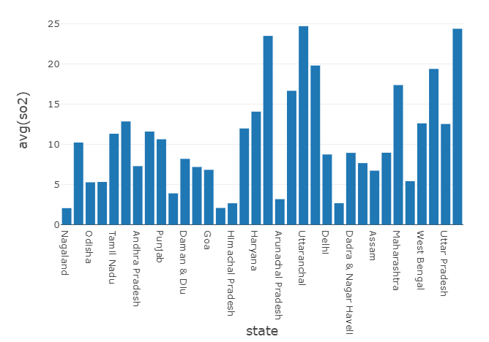
Graphical representation of average so2 for each state:

Slide 21

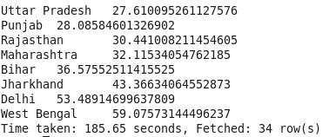
Scenario:4 Fetching the data of NO₂ concentration for each state. Query: output:

Slide 22
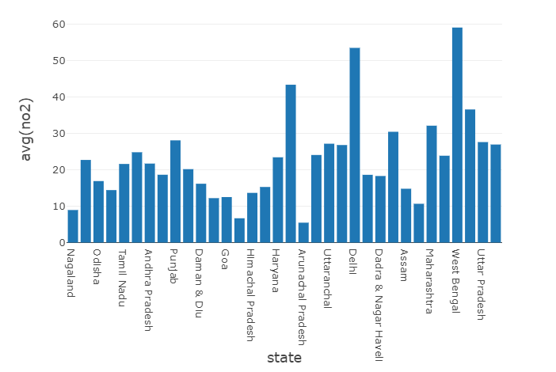
Graphical representation of average no2 for each state:

Slide 23

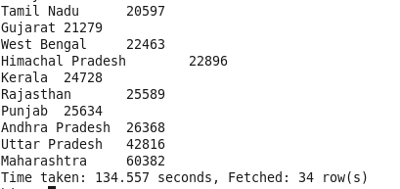
Scenario:5 Fetching the data of states having the best recording network. Query: output:

Slide 24
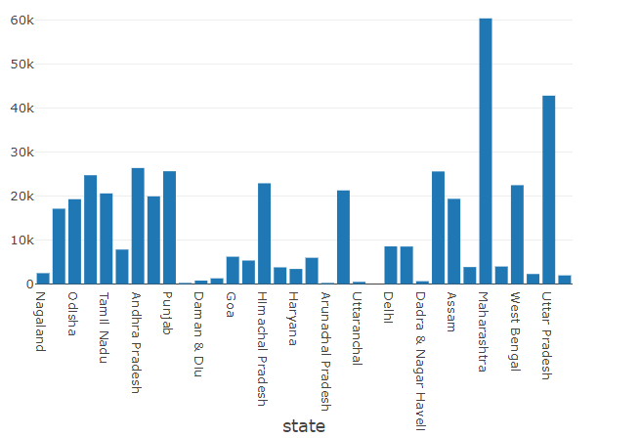
Graphical representation of count of states:

Slide 25


